Slide 1
Knock Detection Reference Code Specification
Steve.Han
17.06.2015

Slide 2
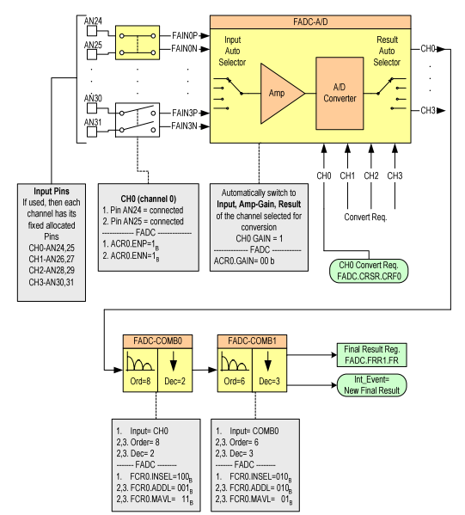
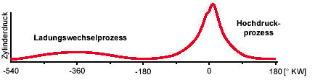
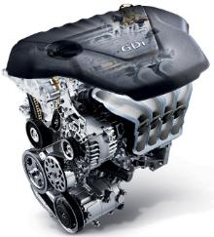
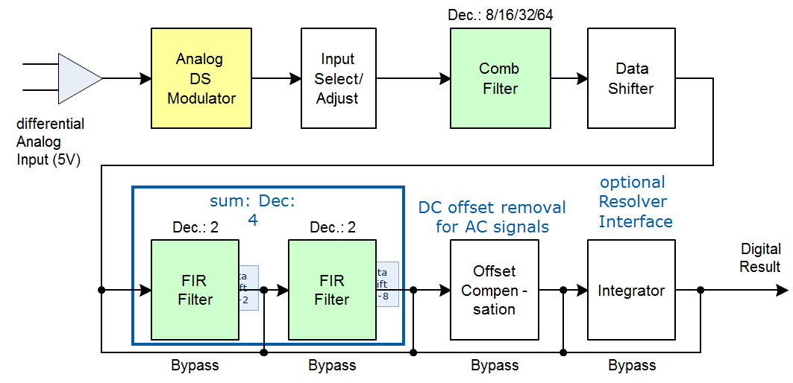
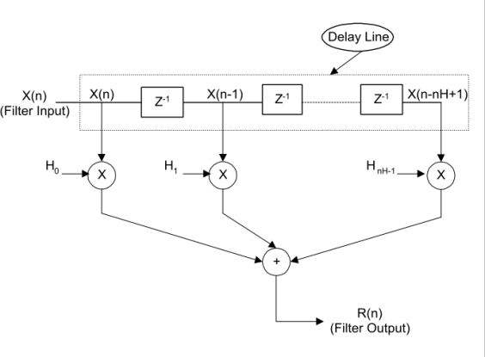
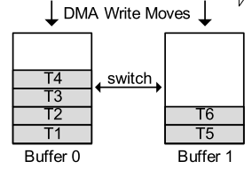

SW concept
Conventional
Anti aliasing FIR
DMA
Knock detection FIR(Coefficient is decide by HMC ASW)
New developed
DMA

Slide 3
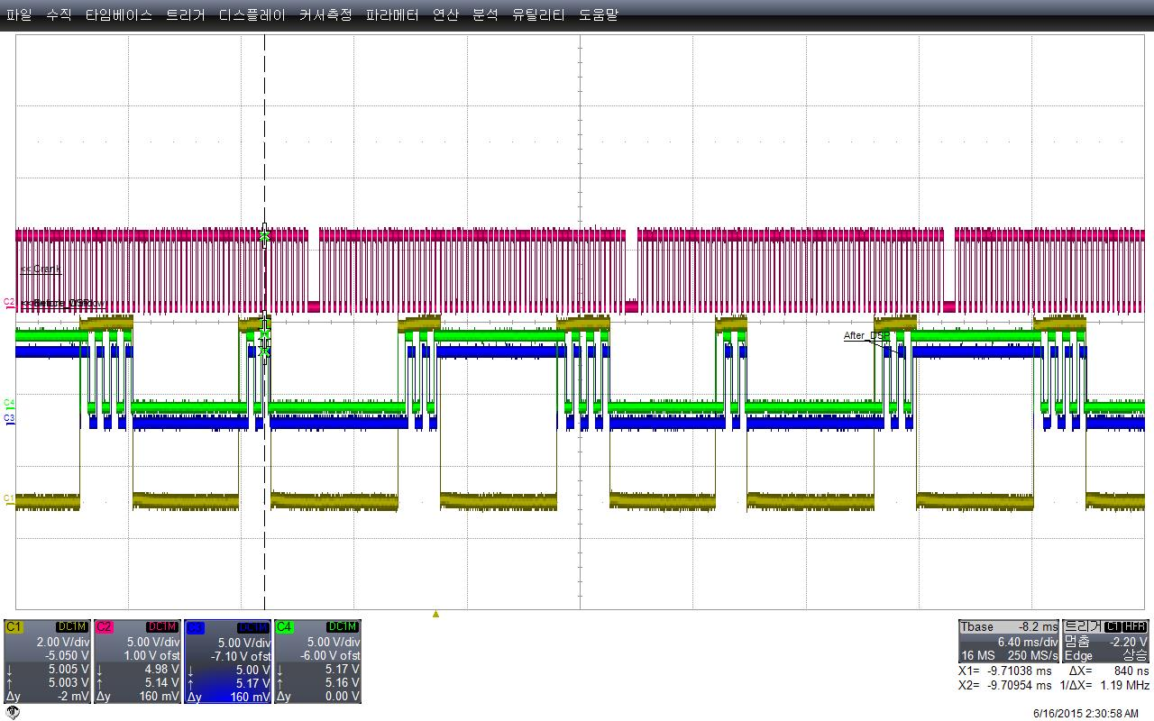
SW Operation
CRANK
KNOCK_WINDOW
DATA_IN
AFTER_DSP

Slide 4
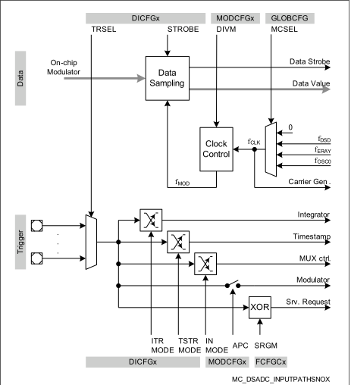
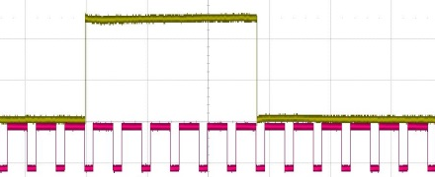
SW Design detail concept-Data generation
DSADC is triggered, when Knock window is high.
Interrupt is generated, when each data is created.

Slide 5
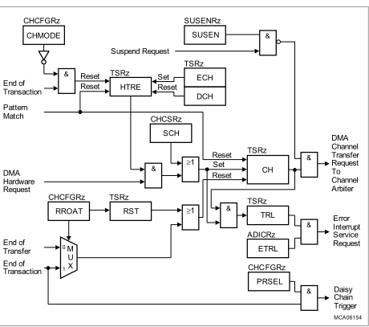
SW Detail design concept-Trigger connection
DMA
DSADC
DSADC IR is connected to DMA Hardware request.

Slide 6
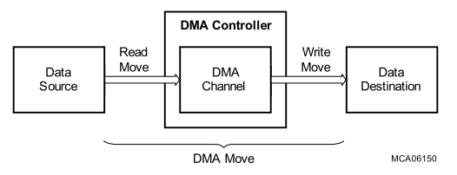
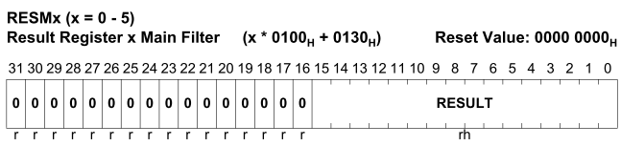
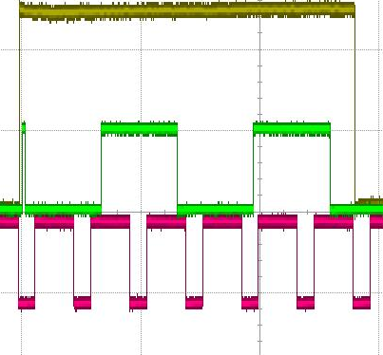
SW Detail design concept-Double buffering
These are buffer switch point.
CRANK
KNOCK_WINDOW
DATA_IN
Using DMA, Generated DATA at DSADC is moved to destination.
At here , DMA use Double buffering functionality.
DMA destination is automatically switched from one to the other when data is filled fully.

Slide 7
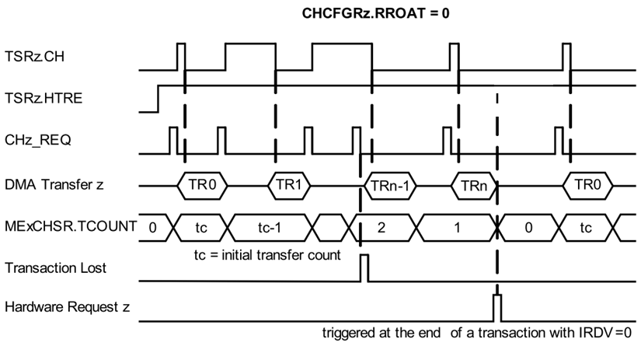
SW Detail design concept-Data transfer
RROAT = 0;
TSRz.CH is reset after each transfer. A transfer request is required for each transfer
CHMODE = 1;
Continuous Mode operation is selected for DMA channel z.
After a transaction, bit TSRz.HTRE remains set

Slide 8
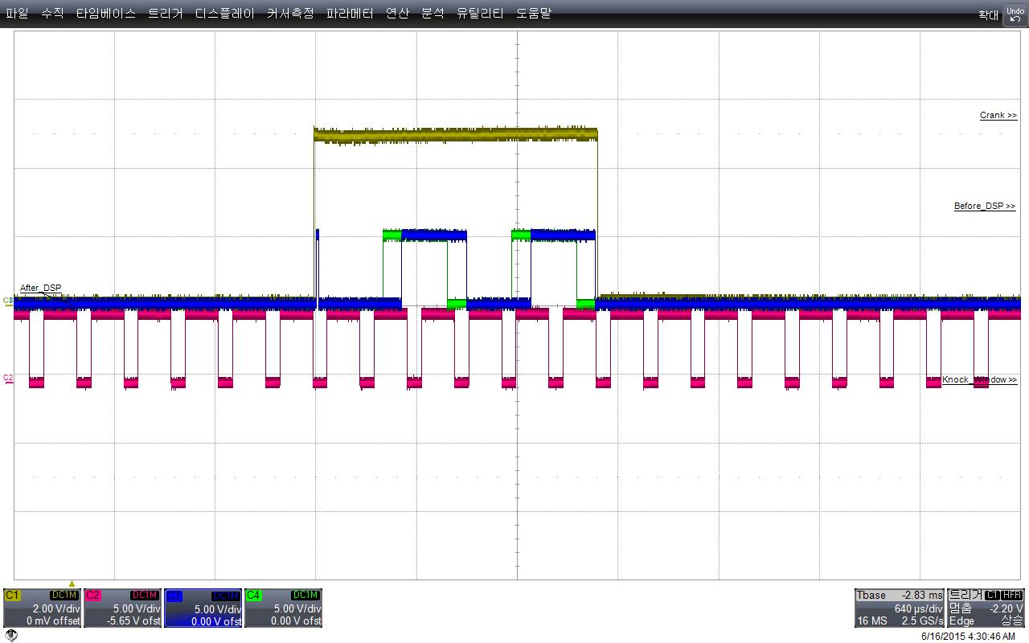

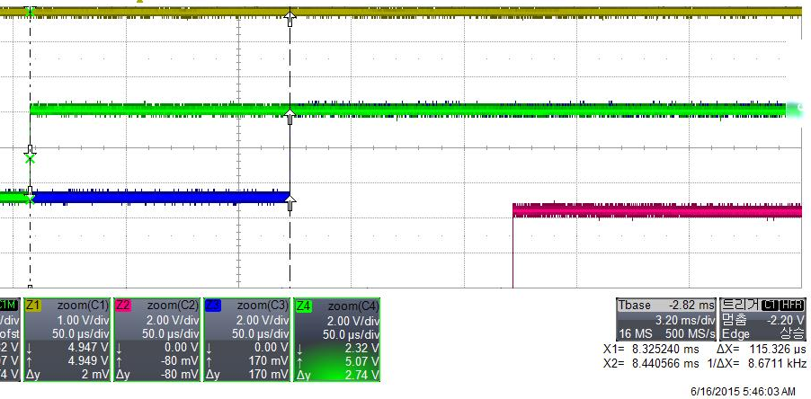
SW Detail design concept-Signal processing
DSP lib Ifx_firRealQ15a is called, when buffer is full
It takes 115.326us(128 Data)
CRANK
KNOCK_WINDOW
DATA_IN
AFTER_DSP

Slide 9
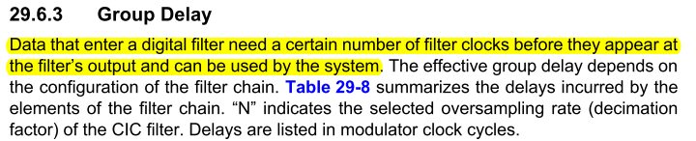
SW Detail design concept-Ignore data
Considering Group Delay, 10 data is ignored.

Slide 10
SW Detail design concept-ISR
Knocheck_Window_ISR is called, when window open or close
DMA_FULL_ISR is called, when buffer is full

Slide 11
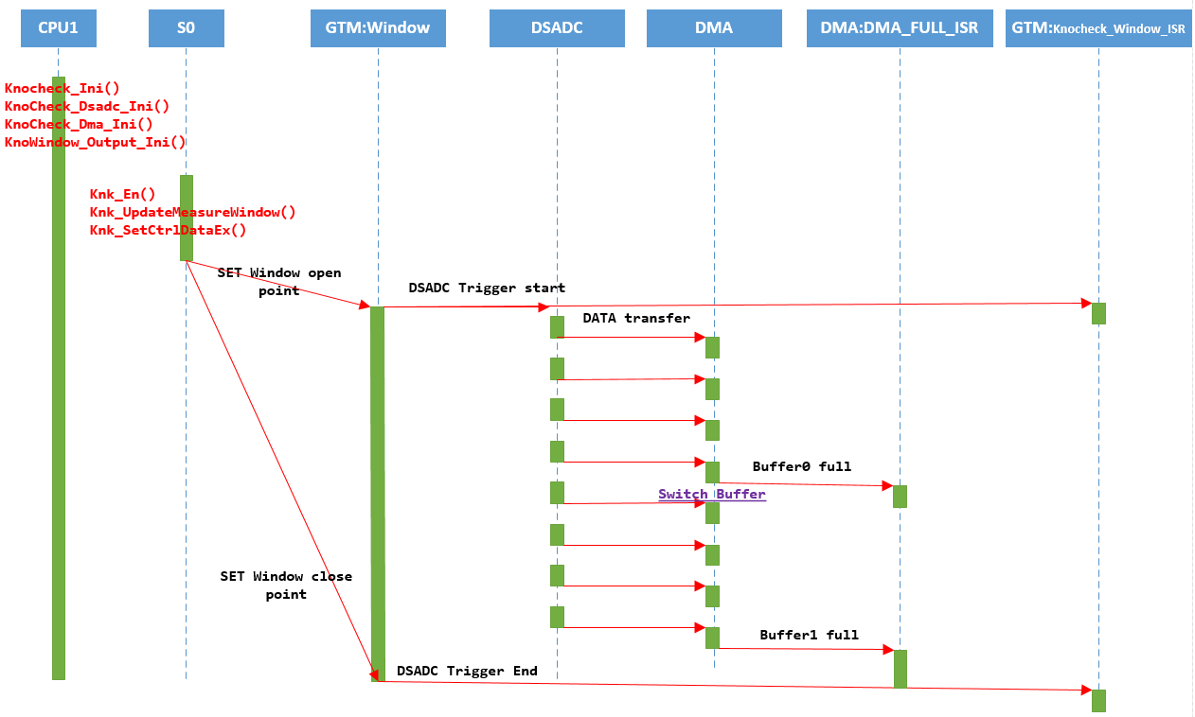
Dynamic view

Slide 12
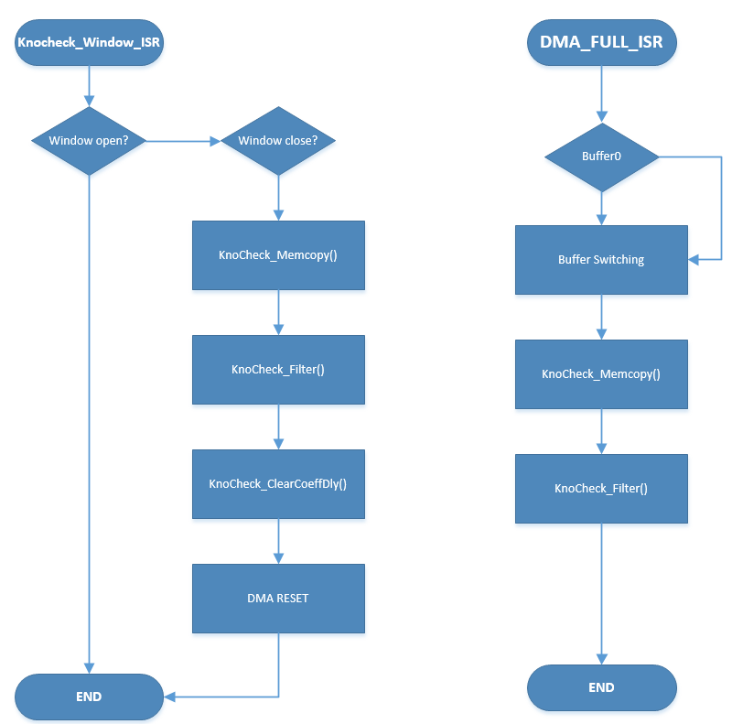
ISR Flowchart

Slide 13
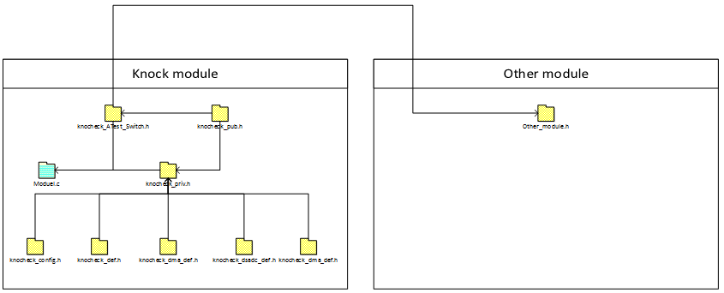
Module Interface

Slide 14
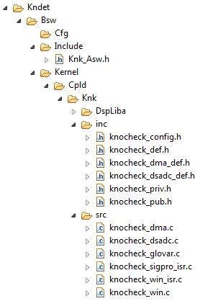
Folder structure
knocheck_config.h: All system dependent defines are in here.
knocheck_def.h: General knock dependent defines, structures, enums are in here.
knocheck_dma_def.h: DMA dependent defines, structures, enums are in here.
knocheck_dsadc_def.h: DSADCdependent defines, structures, enums are in here.
knocheck_priv.h: Knock module extern, includes are in here.
knocheck_pub.h: Interface function and values are in here. Other modules are can access this module only through this header file.
knocheck_dma.c: DMA Initialization functionality is in here
knocheck_dsadc.c: DSADC Initialization functionality is in here
knocheck_glovar.c: All global values are in here
knocheck_sigpro_isr.c: IR is occurred, when destination buffer is full. Accumulate datas are filter calculated at here.
knocheck_win_isr.c: IR is occurred, when window open or close. Accumulate datas are filter calculated at here.
knocheck_win.c: Knock Window Initialization functionality is in here

Slide 15

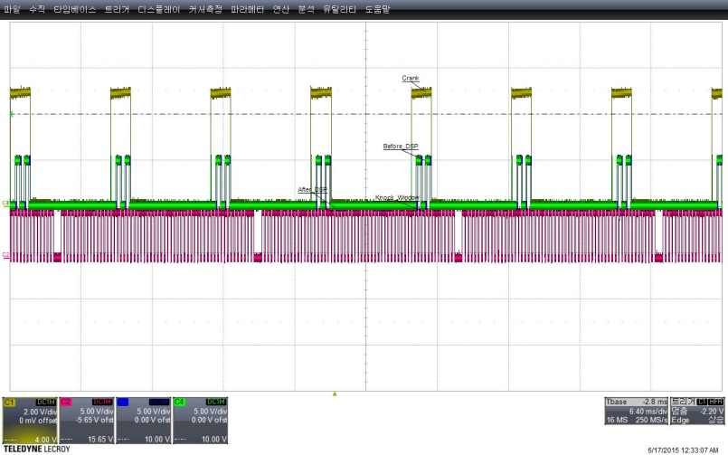
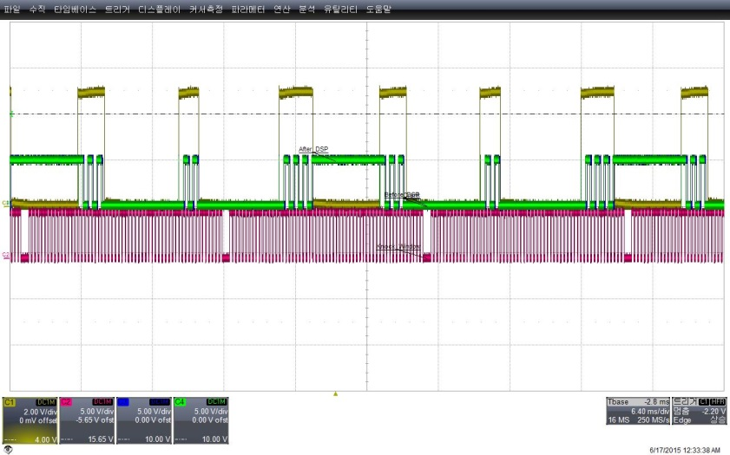
Test Result-Window length change

Slide 16
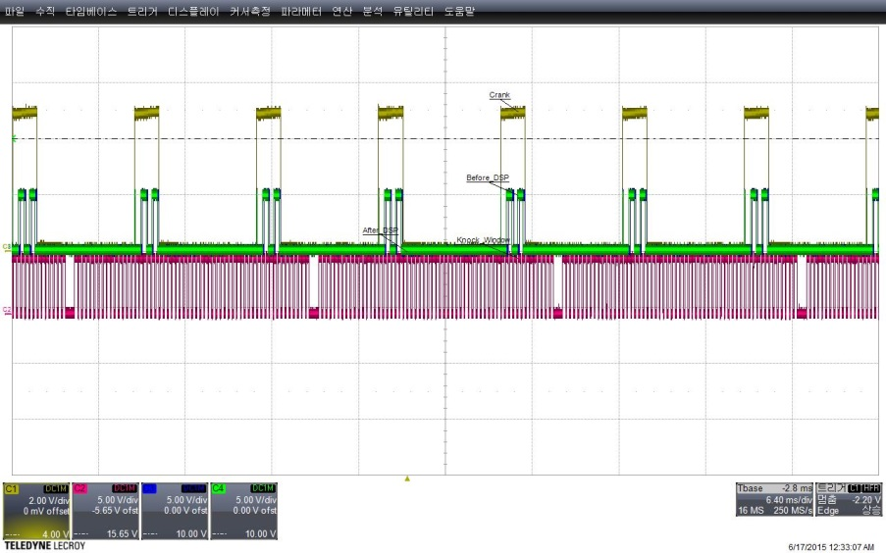
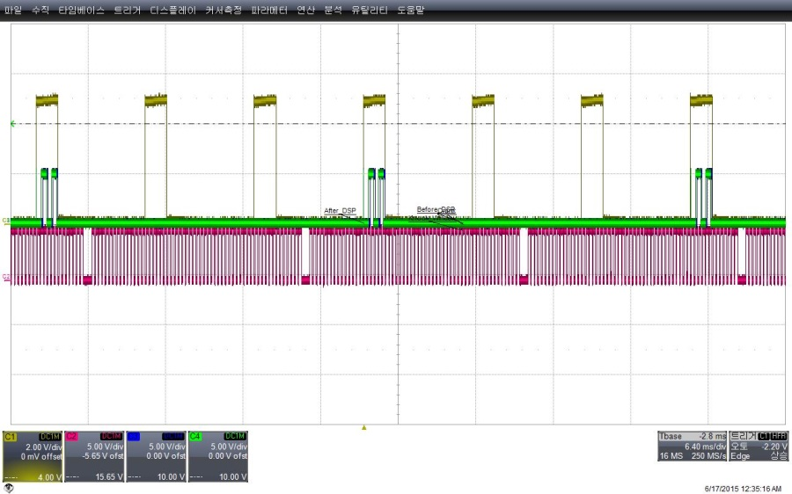
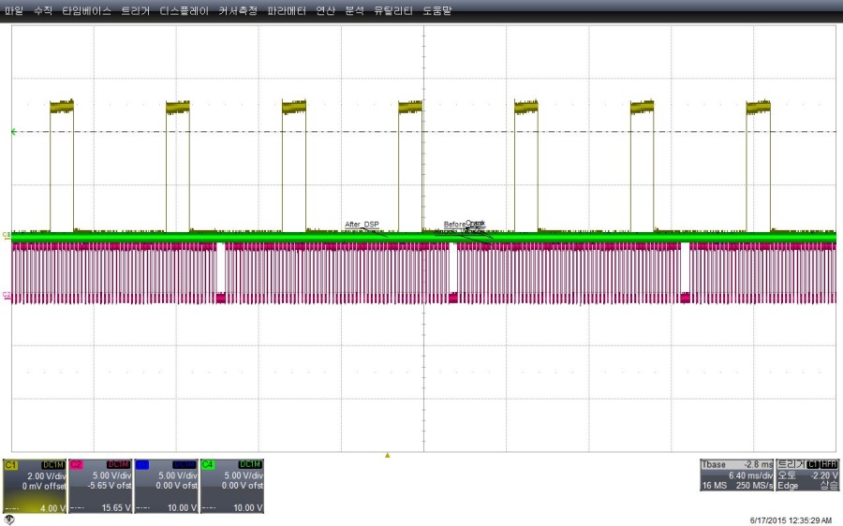
Test Result-Module Enable

Slide 17
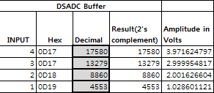
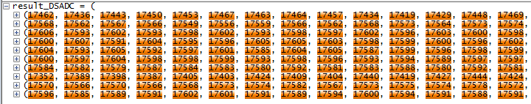
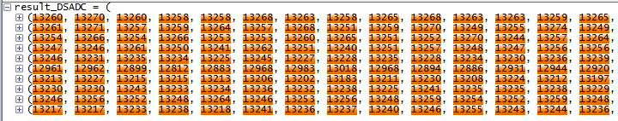
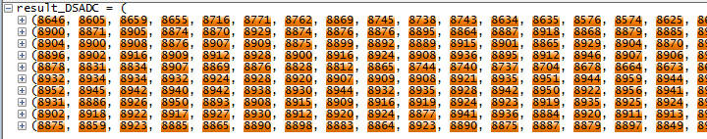
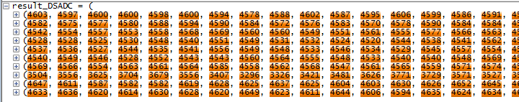
Test Result-DSADC measurement
Calculated Value
Measurement Value

Slide 18
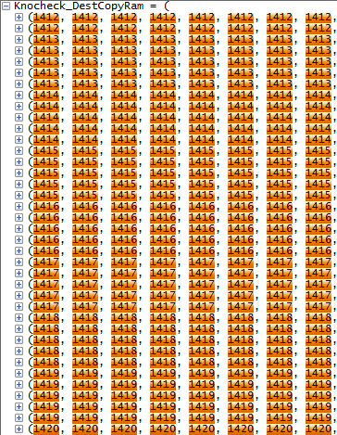
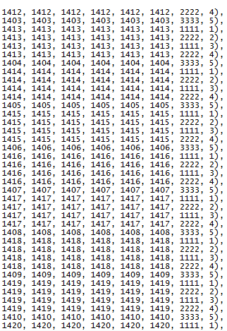
Test Result-Data input validation
Input data order
1111:buffer 0
2222:buffer 1
3333:Window close buffer 0
4444:Window close buffer 1

Slide 19
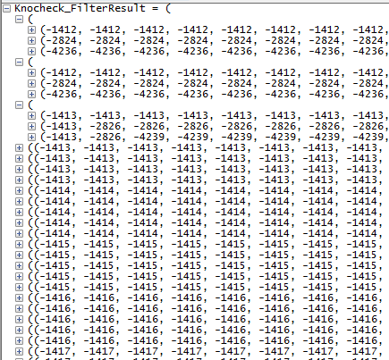

Test Result-Signal processing

